Slide 1
18 Interesting Ways* to use a Visualiser in the Classroom
*and tips
This work is licensed under a Creative Commons Attribution Noncommercial Share Alike 3.0 License.
Notes:
Many thanks to edte.ch for sharing a brilliant resource

Slide 2
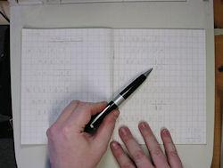
#1 - Use it to peer review lesson work
Place a piece of work on the visualiser at the end of a lesson, and allow the class to discuss the positive features of the work produced.
Why not go a step further and allow the children to create the "3 stars and a wish" for the work (3 good points, and something to aim for in the next piece of work).

Slide 3
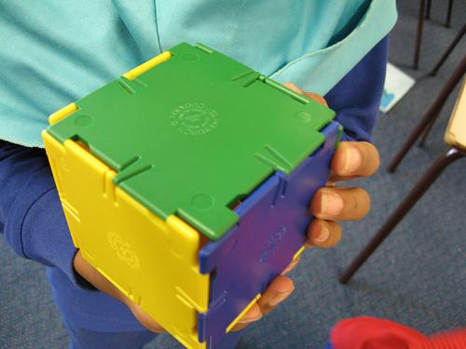
#2 - Use it to model nets of shapes
In numeracy activities, you can place a net of a shape on the visualiser, and invite pupils to come out and construct the 3D shape.
The rest of the class can view the process of constructing the shape.
If you use the video function within some visualisers, you can also record the pupils as
they work through the problem, and save it as evidence of their understanding.

Slide 4
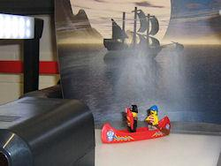
#3 - Make an animation
Use the camera to make an animation. Design some split pin models (to create limb movement), use fuzzy felt shapes, or just draw a
character, and place them over a background.
Take a photograph of the scene, before moving the character slightly. Put them all together in moviemaker or 2animate to make a movie.
If your visualiser allows you to rotate the camera angle, you can create 3D animation too using plastic brick characters.

Slide 5
#4 Use it to Investigate Magnetic Fields
Use bar magnets and iron filings to show magnetic field patterns of a single magnet, then pairs of attracting and repeling magnets.
Children predict what patterns will be like with other magnets of different shape or strength e.g. horseshoe, ring etc
Individuals and groups can test out their predictions and then show their results to the rest of the class

Slide 6
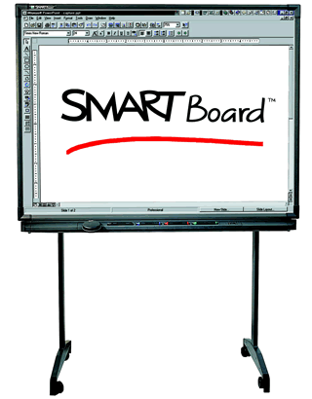
#5 Combine it with a Smartboard
If you can connect your visualiser to a Smartboard, then you can grab an image of a piece of work and manipulate it.
Take a piece of text and grab the image on the Smartboard. Blank out some of the words - can the children correctly work out the missing content?
Flick back to the visualiser image to compare their choices.
Take a child's piece of writing and - using the Ink Layer on a Smartboard - write over the top of the work without ruining the original.

Slide 7
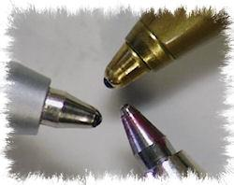
#6 Use it as a magnifying glass
Some visualisers have an impressive zooming ability within their camera. Use this facility to take a closer look at objects during lessons.
Zoom in on a flower to look inside the petals.
Zoom in on a drop of water to see the shape it makes.
Zoom in on a tissue to see the fibres that it contains.
Zoom in...
If the camera can be rotated, take a close look at objects from different angles too.

Slide 8
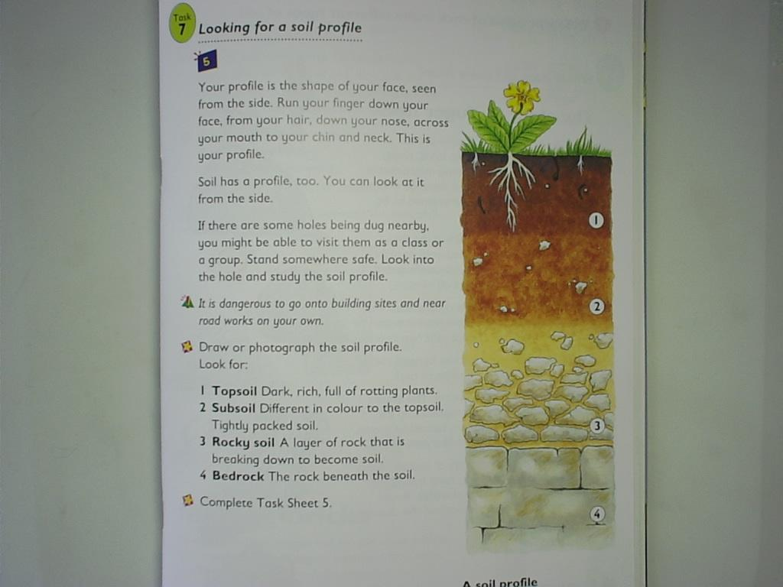
#7 Class Texts on the IWB
Rather than photocopy 30 versions of a page of text to use in a literacy lesson - put the book you are using on the visualiser. That way everyone in the class can see it easily.
You can also point to a particular word / sentence and the whole class can see where you are pointing.
Use the visualiser with a Smartboard and you can grab the page of text and annotate it with pupil comments, thoughts and ideas.

Slide 9
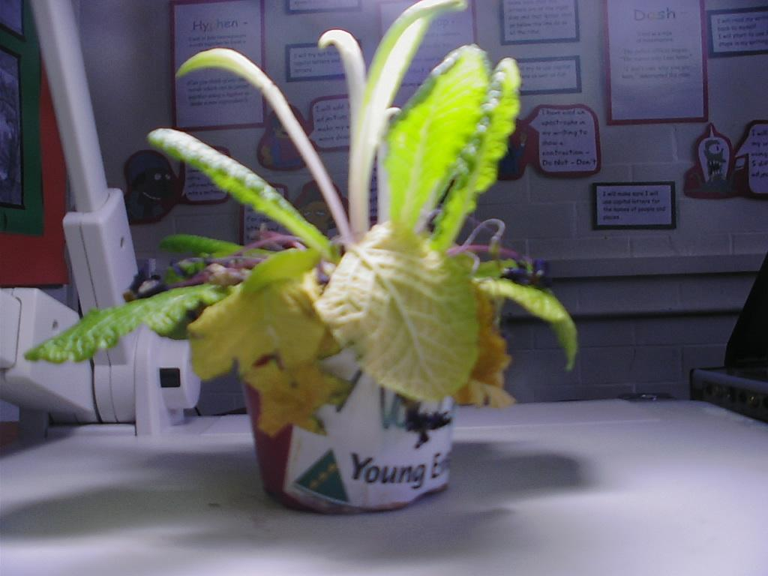
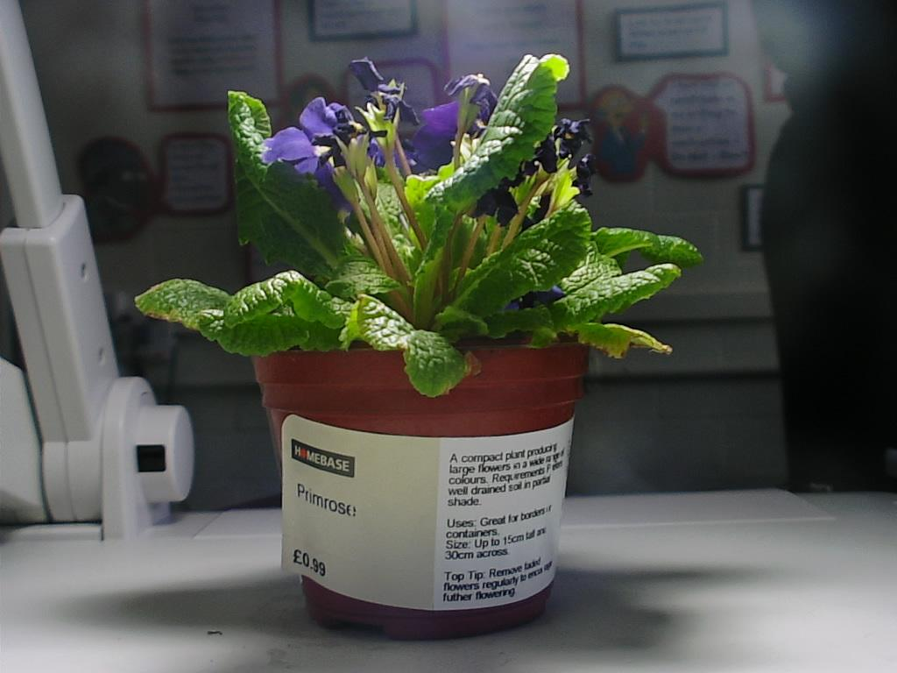
#8 View changes over time
Watch a plant grow over a period of time. Place the plant on the visualiser and take a photo of it. Over a week / month repeat this once a day.
Watch the images back using the "slideshow" option in windows photo album folders to view the changes to the plant.

Slide 10
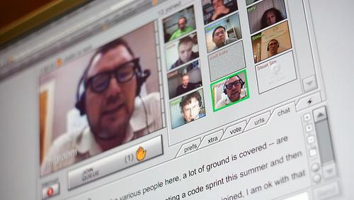
#9 Use it as a Webcam
If you can rotate the camera on your visualiser, you can point the lens towards the class and use it to video conference.
You will still need to install video conferencing software on the computer, and tell the software to use the visualiser as a webcam, and you might need an external mic.

Slide 11
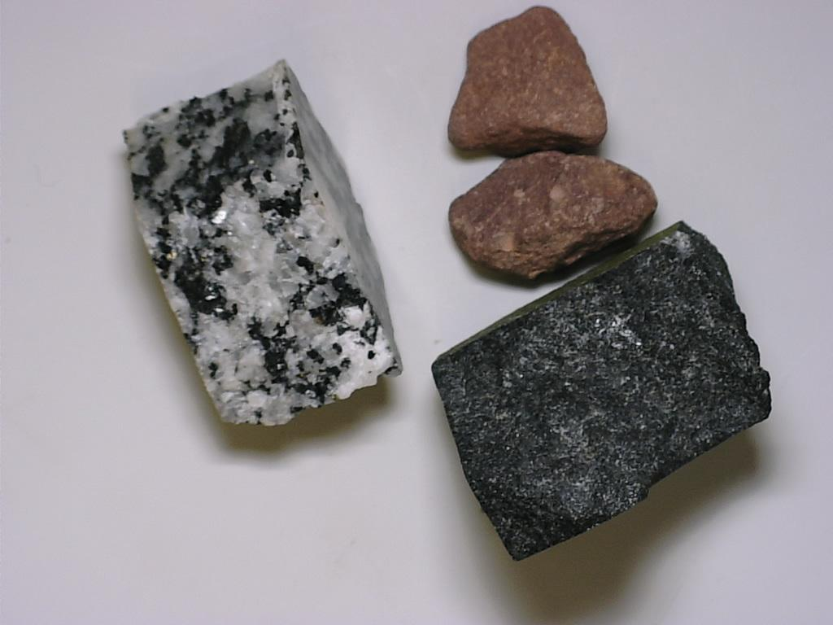
#10 Model skills to the whole class
Show the class how to perform a particular skill easily by demonstrating it on the visualiser;
Model handwriting styles
Demonstrate an art technique
Model a procedure in Maths
Demonstrate needlecraft
Model a science investigation
Show how to read a thermometer
Show how to use a protractor

Slide 12
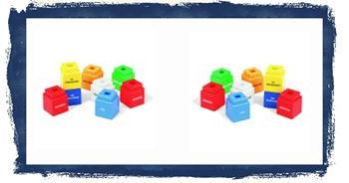
#11 Use it to learn about symmmetry
If you've got a visualiser with lots of extra features, you might have one that allows you to freeze the image, and then split the screen. If so, you can use the visualiser for all sorts of symmetry work.
Place some coloured cubes on the visualiser base and freeze the image. Once you've split the screen you can let children show how the cubes will appear if reflected.

Slide 13
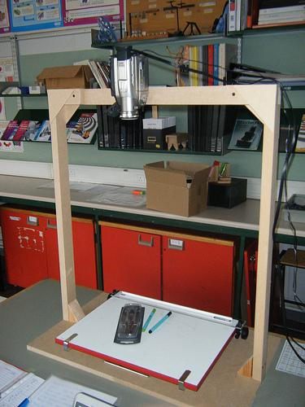
#12 Make your own visualiser for £30
For about £20 you can get a good camcorder from ebay. Spend another few pounds making a rig for it and you have a very cheap visualiser!
This is great when a visualiser just won't fit enough into screen - like when drawing on A3 paper.
Use it to model exactly what the pupils have to do without them crowding round one desk

Slide 14
#13 Use it in assembly
If you have a projector in the hall, you could use a visualiser in assembly. It could be used to display a visual aid, share good work, or to show words for hymn practice.
Tip: If you have hymns on acetates, place a plain sheet of paper under the acetate. This will help the visualiser to show the text more clearly.

Slide 15
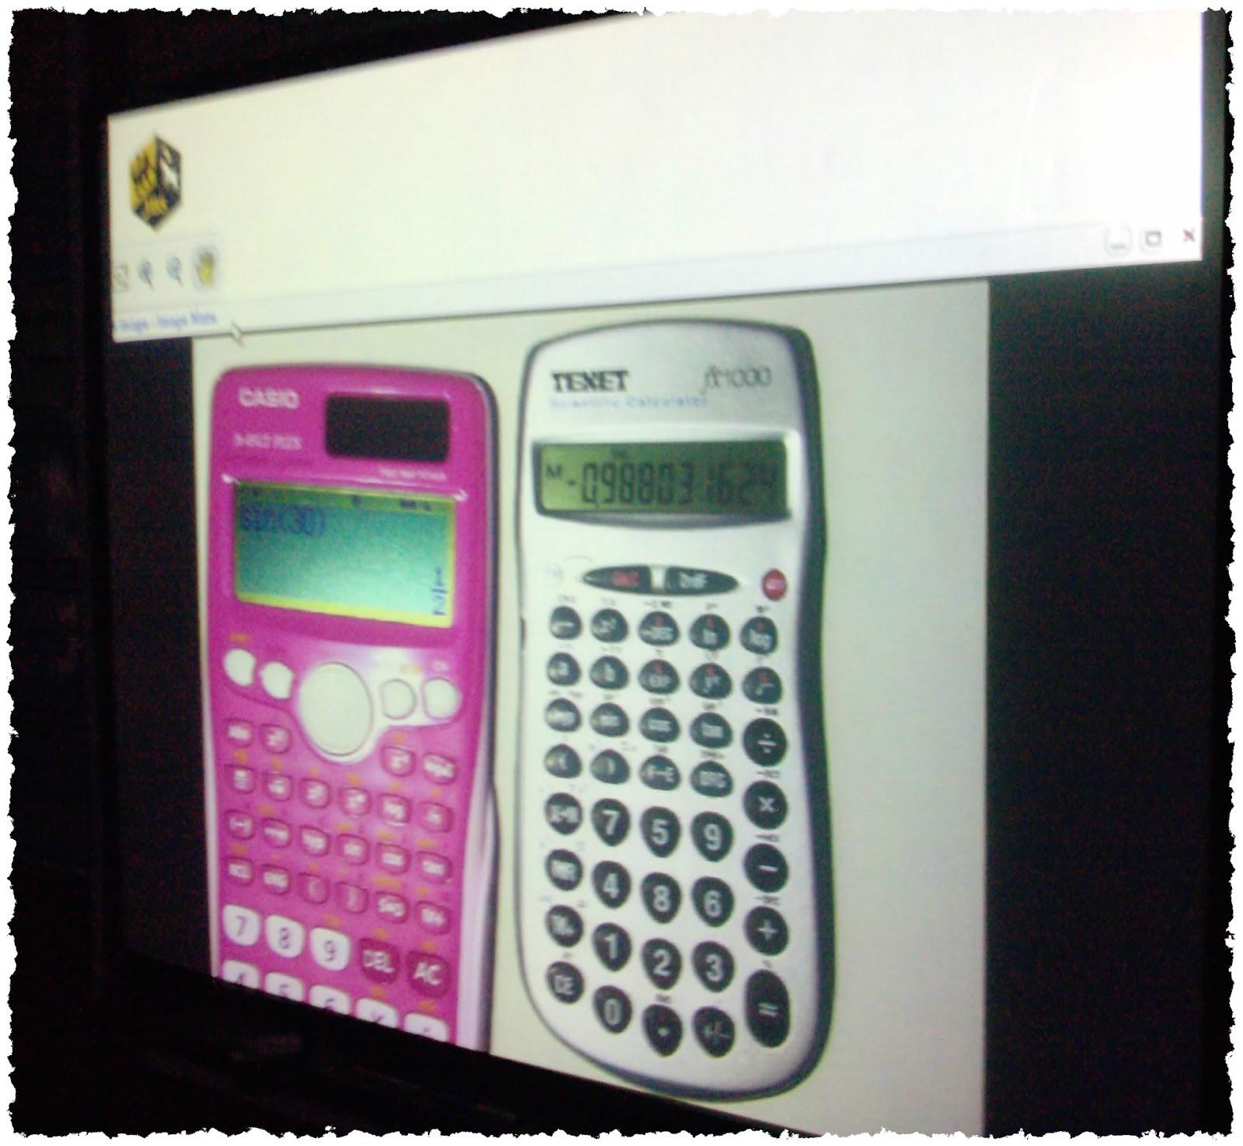
#14 - Teach Calculator Use
Different calculators work differently. Use the visualiser to show how to efficiently use each of the most common models.
In real time you can show how to convert from Degrees to Radians modes, or how to use the fraction button or convert from surd to decimals etc...
From @Chris_1974

Slide 16
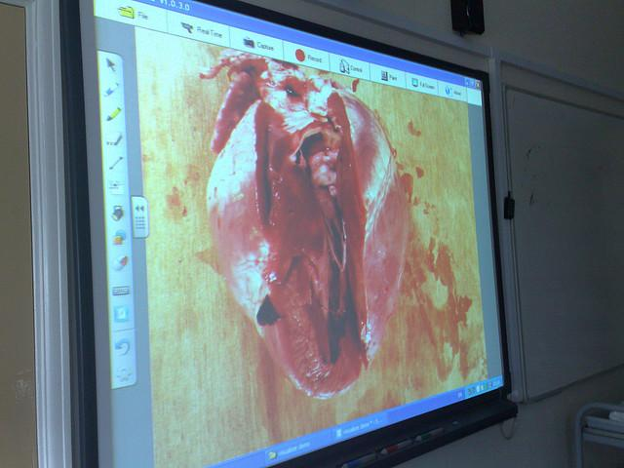
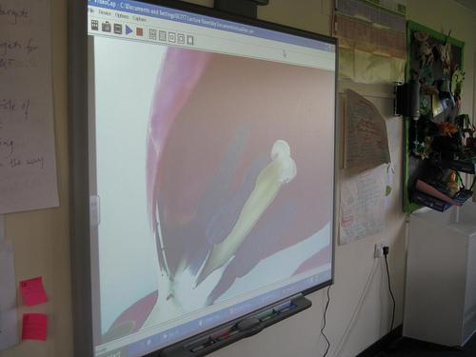
#15 Dissections in Science
Get a close up view of flower, organ and other dissections without having a whole class crowded round a table. Can annotate over top of images when displayed in IWB.
Can save images for use later.
@dannynic

Slide 17
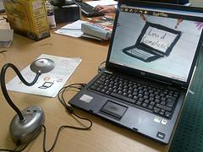
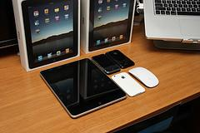
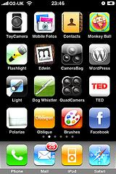
#16 Sharing apps using ipad/ipod
Select and download excellent apps for learning, such as, Epic Citadel, Dragon Dictation, Percy Parker sings the Times Tables, Puppet Pals, Tribbs to name a few. Then use your visualiser to project these through your IWB for all to share.
@nickynewbury

Slide 18
#17 A portable Visualiser
If you have an android phone, you can download (free) ipwebcam.
This is a simple piece of software that can feed your android phone camera to your IWB. No need to get student work to the front, simply wander around the class, and point your phone.
@Chris_1974
(pictures to follow).

Slide 19
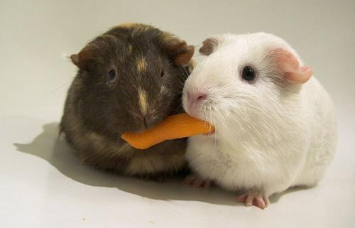
If you would like to:
Contribute your ideas and tips to the presentation.
Let me know how you have used the resource.
Get in touch. You can email me or I am @tombarrett on Twitter
If you add a tip (or even if you don't) please tweet about it and the link so more people can contribute.
I have created a page for all of the Interesting Ways presentations on my blog.
The whole family in one place :-)
Image: ‘Sharing‘
Thanks for helpingTom Barrett
Have you seen Maths Maps yet?

